Slide 1

By Elke Hansen

Slide 2
Recommendation Engines
Pros:
Range from simple to complex
Easy to implement
Continue to improve over time
Increased consumption and higher profits
Reduce customer churn
Cons:
Require a large amount of data storage and infrastructure
Initial calculation processing
Require regular maintenance
Fun Fact:
Amazon make 35% of their sales through recommendations

Slide 3
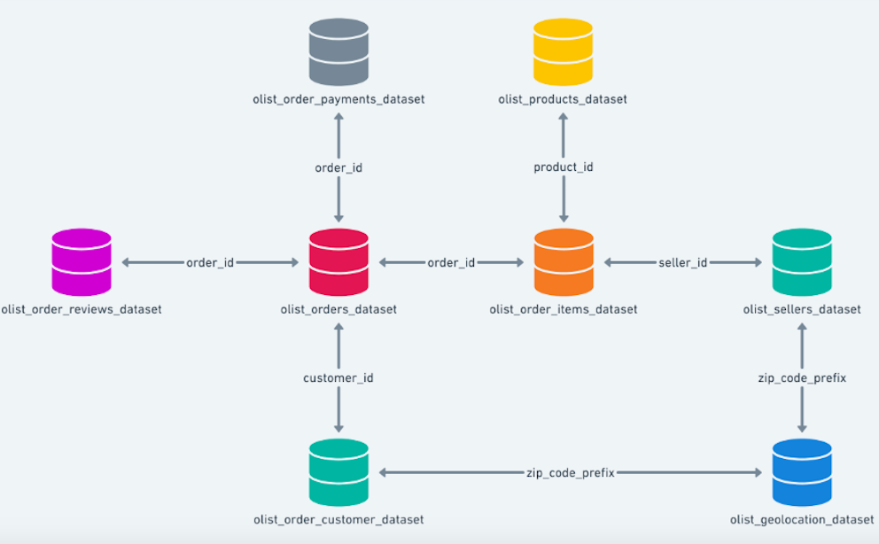
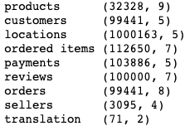
Data Schema: Brazilian E-Commerce - Olist
8 different dataframes plus 1 for translating category information
Varying shapes across each one:

Slide 4
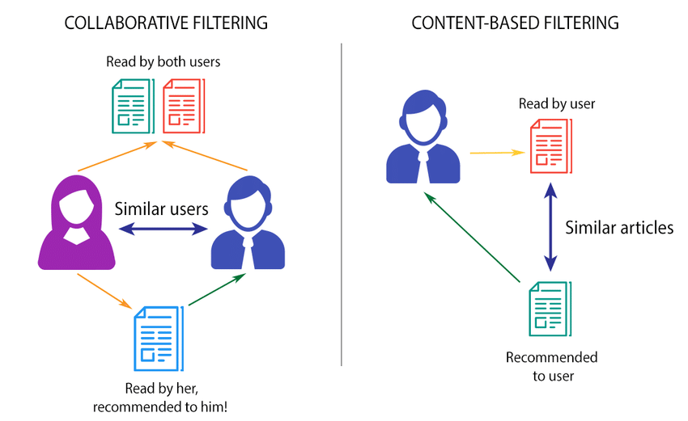
How Does It Work?
Collaborative filtering:
- Needs a large amount of customer data
Content-based Filtering:
- Needs a large amount of product based data
As you get more information about customer, transition from content based to collaborative

Slide 5
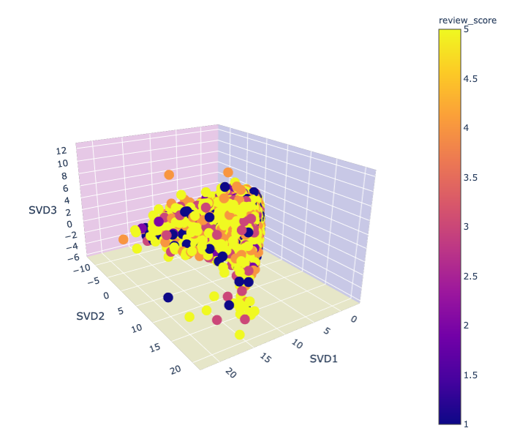
Key Concepts
Customers versus products in 3D
Project the products into multi-dimensional space based on their common customers :
- TFIDF Vectorizer
- Truncated SVD
Measure the angle between each customer
- Cosine Similarity
Store each products similarities in a database
Recommend products based on what their most similar products that customers have purchased

Slide 6

Future Challenges:
Further develop strategy to incorporate future sales
Combination of models for increased complexity
Creation of web based application
Challenges:
Dataset: not a large amount of customer purchases
Figuring out how to fit the results of other models into the recommendation model
Volume of data and calculation times

Slide 7
Questions?

